Slide 1
Similarity
Lesson 3 – Similar Triangles

Slide 2
Similar Triangles
2. SSS
1. AAA
3. SAS
4. RHS
Notes:
https://www.mathsisfun.com/geometry/triangles-similar-finding.html

Slide 3
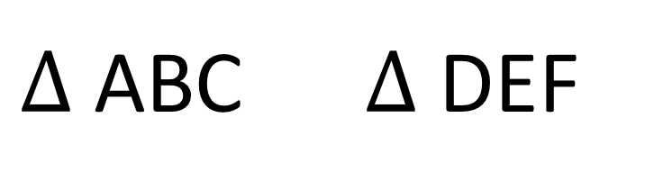
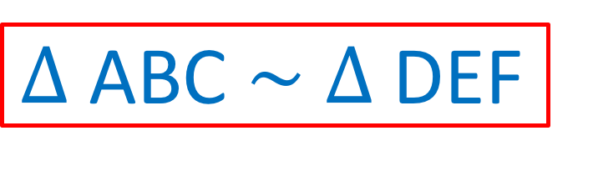

NOTATION
If triangle ABC is similar to triangle DEF, we can then write the following:
$∆$ ABC $\sim$ $∆$ DEF
or
$$≡$$
$∆$ ABC $∆$ DEF

Slide 4
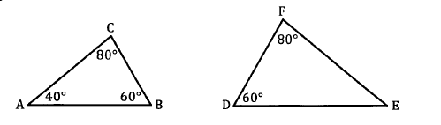
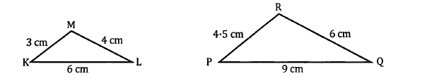
Examples

Slide 5
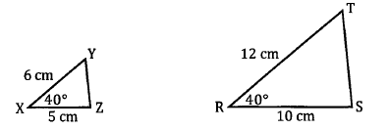


Slide 6
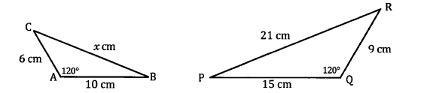
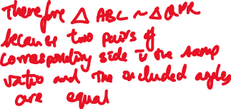
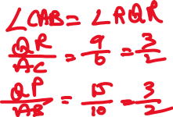
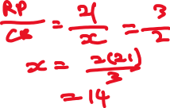

Slide 7
Example
Given ∆ ABC ~ ∆ XYZ, find the length of AB.
Notes:
https://www.mathsisfun.com/geometry/triangles-similar-finding.html

Slide 8
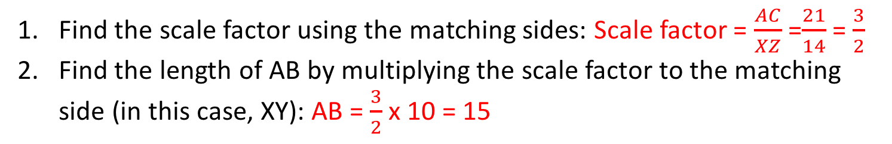
10
14
Find the scale factor using the matching sides: Scale factor = $\frac{AC}{XZ}$ =$\frac{21}{14}$ = $\frac{3}{2}$
Find the length of AB by multiplying the scale factor to the matching side (in this case, XY): AB = $\frac{3}{2}$ x 10 = 15
Notes:
https://www.mathsisfun.com/geometry/triangles-similar-finding.html

Slide 9
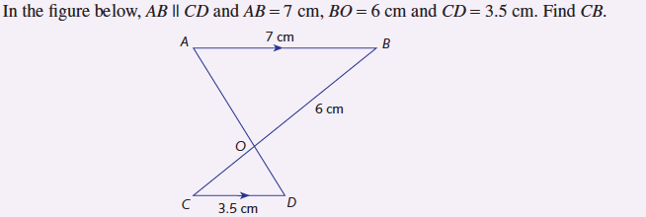

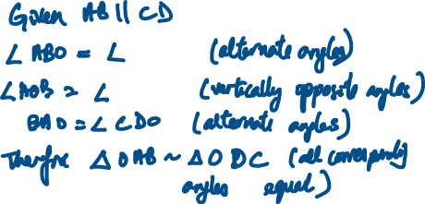
Example 4

Slide 10




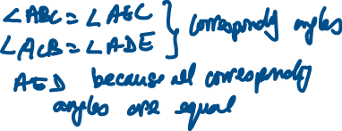





Example 5
E
Find the length of BC given the BC is parallel to DE.
12 cm
B
5 cm
3 cm
A
2 cm
C
8 cm
D

Slide 11


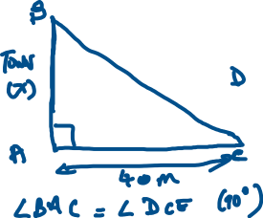




Example 6

